Slide 1


Research Computing
University of Wisconsin – Madison

Slide 2
Post-estimation Parameter Recentering and Rescaling
Doug Hemken
Notes:
Hello.
I was drawn into the problem of recentering and rescaling parameters a couple of years ago, when one of our post-docs came to me with a simulation she wanted help with.
She was writing for a Psychology journal that required all results to include standardized coefficients, so she needed to simulate both her original model and the standardized one.
She had her original model, and the descriptive statistics, but she had changed Universities and no longer had access to the data.
A main point of her model was it’s interaction term.
Her model was simple enough that it could be solved with high-school algebra, but it got me interested in the bigger question.

Slide 3
Recentering as change of basis

Slide 4
Recentered polynomial regression (change of basis)
Notes:
Recentering and rescaling data can be thought of as just a change of coordinates, or a change of basis.
Looking at a graph like this one, it is fairly intuitive that the relationships among the data points, and with the fitted line have not changed, but we have changed how the axis is labeled.
Here, the predicted values and the residuals are exactly the same.
A change of basis in the data induces a natural and intuitive change of basis for the parameters as well. So there is a linear transformation that takes our parameters, expressed in the original terms, and converts them to the new basis.

Slide 5
Recentered polynomial regression (change of basis)
. estimates table Original Centered, se
-------------------------------------------
Variable | Original Centered
----------------+--------------------------
displacement | 13.292618 8.2613721
| 2.1114091 .49321693
|
c.displacement#|
c.displacement | -.01275042 -.01275042
| .00461032 .00461032
|
_cons | 999.27223 3125.5442
| 211.52293 54.591876
-------------------------------------------
legend: b/se
Notes:
Just looking at the numerical results, it is less intuitive that the Centered coefficients are a linear transformation of the Original ones.
But they are.
And we can write this linear transformation as a matrix.
I have written a little Stata code that generates this matrix, and uses it as a post-estimation command to center and standardize model coefficients.

Slide 6
Math – Linear Algebra of Recentering and Rescaling
Building Blocks – Simple regression models
Recentering
Rescaling
Adding Interactions – Factorial regression models
Full factorial
Partial
Adding Categorical terms
Untransformed
Recentering via contrasts
Group like terms – Polynomial models
Notes:
I want to outline the math first, and then sketch the Stata programming.
And this will be a hand-waving overview.
We’ll start with ….

Slide 7

Simple regression recentering
Given a model
$y=β_{0}+β_{1}x$
And a recentering constant
$Δx=x −μ$
Then the recentered model
$y=β_{0}^{Δ}+β_{1}^{Δ}Δx$
Has parameters given by
$B^{Δ}=\left[\begin{matrix}1 & μ \\ 0 & 1\end{matrix}\right]B$ , or
$\left[\begin{matrix}β_{0}^{Δ} \\ β_{1}^{Δ}\end{matrix}\right]=\left[\begin{matrix}1 & μ \\ 0 & 1\end{matrix}\right]\left[\begin{matrix}β_{0} \\ β_{1}\end{matrix}\right]$
Notes:
Recentering parameters in the simplest regression model is very simple.

Slide 8
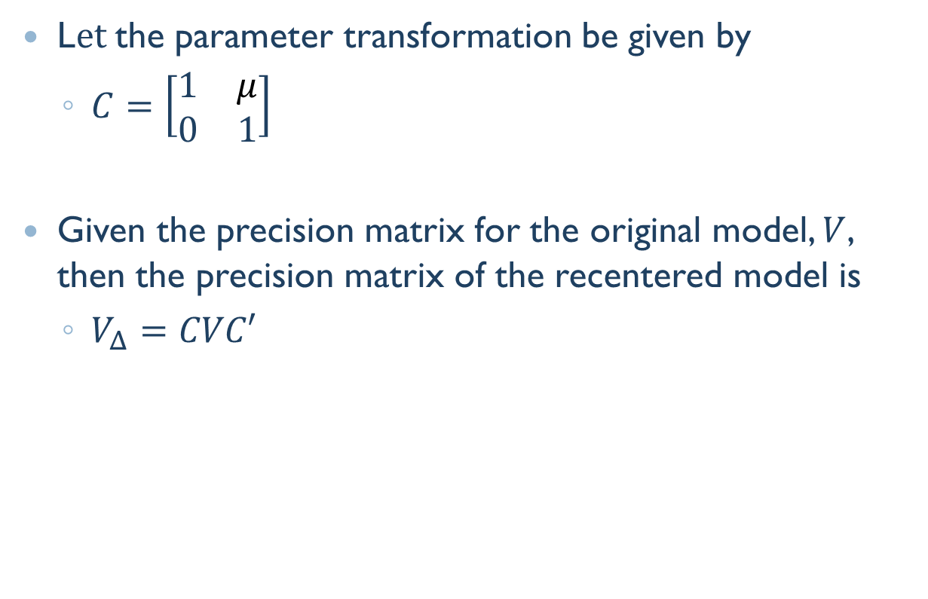
Precision matrices
L$et$the parameter transformation be given by
$C=\left[\begin{matrix}1 & μ \\ 0 & 1\end{matrix}\right]$
Given the precision matrix for the original model, $V$, then the precision matrix of the recentered model is
$V_{Δ}=CVC′$
Notes:
The change to the precision matrix is equally simple.
If we call the parameter transformation matrix C, we can use it to change the basis for the precision matrix this way.
In all the transformations that follow, this is how we deal with the precision matrix, so I won’t talk about it any more.
But this is kind of a useful matrix.

Slide 9

Recentering y
Given
$y=β_{0}+β_{1}x$
$Δx=x −μ_{x}$
$Δy=y −μ_{y}$
Then
$Δy=β_{0}^{Δy}+β_{1}^{Δ}Δx$
Is
$B^{Δy}=\left[\begin{matrix}1 & μ_{x} \\ 0 & 1\end{matrix}\right]\left[\begin{matrix}β_{0}+μ_{y} \\ β_{1}\end{matrix}\right]$
Notes:
Recentering y only changes the intercept in the model, and we could write this a couple of different ways.
The real point is that it doesn’t change the parameter transformation matrix, and we won’t need to consider it much further.

Slide 10

Simple regression rescaling
Given a model
$y=β_{0}+β_{1}x$
And a rescaling constant
$z=x/σ$
Then the rescaled model
$y=β_{0}^{z}+β_{1}^{z}z$
Has parameters given by
$B^{z}=\left[\begin{matrix}1 & 0 \\ 0 & σ\end{matrix}\right]B$
Notes:
Rescaling a simple regression is as simple as recentering.
The matrix looks like this.

Slide 11

Rescaling y
From
$y=β_{0}+β_{1}x$
$z=x/σ_{x}$
$y_{s}=y/σ_{y}$
To
$y_{s}=β_{0}^{zy}+β_{1}^{z}z$
Is
$B^{zy}=\frac{1}{σ_{y}}\left[\begin{matrix}1 & 0 \\ 0 & σ\end{matrix}\right]B$
Notes:
Rescaling y again has no effect within the transformation matrix, it is just a scalar transformation of the whole thing.
So we won’t worry about y in what remains.

Slide 12

Standardizing x
Combine the two simpler transformations
$$B^{std}=\left[\begin{matrix}1 & 0 \\ 0 & σ\end{matrix}\right]\left[\begin{matrix}1 & μ \\ 0 & 1\end{matrix}\right]B$$
Notes:
Standardizing is just centering and then rescaling.

Slide 13
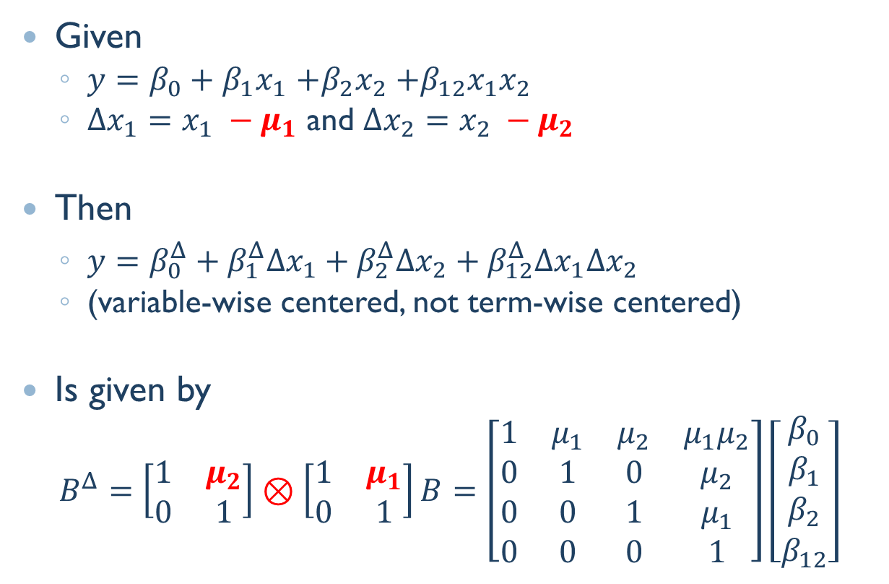
Factorial model recentering
Given
$y=β_{0}+β_{1}x_{1}$ $+β_{2}x_{2}$ $+β_{12}x_{1}x_{2}$
$Δx_{1}=x_{1} −μ_{1}$ and $Δx_{2}=x_{2} −μ_{2}$
Then
$y=β_{0}^{Δ}+β_{1}^{Δ}Δx_{1}+β_{2}^{Δ}Δx_{2}+β_{12}^{Δ}Δx_{1}Δx_{2}$
(variable-wise centered, not term-wise centered)
Is given by
$$B^{Δ}=\left[\begin{matrix}1 & μ_{2} \\ 0 & 1\end{matrix}\right]⊗\left[\begin{matrix}1 & μ_{1} \\ 0 & 1\end{matrix}\right]B=\left[\begin{matrix}1 & μ_{1} & μ_{2} & μ_{1}μ_{2} \\ 0 & 1 & 0 & μ_{2} \\ 0 & 0 & 1 & μ_{1} \\ 0 & 0 & 0 & 1\end{matrix}\right]\left[\begin{matrix}β_{0} \\ β_{1} \\ β_{2} \\ β_{12}\end{matrix}\right]$$
Notes:
Factorial models add interaction terms, and this is where we start to build.
Variable-wise recentering.
We combine our building blocks with a “direct product” or “Kronekcer product”.
There is a theorem about change of basis in tensors that underlies this step.
The resulting linear transformation has a characteristic pattern.
(It also implies a particular order to our vector of parameters.)

Slide 14
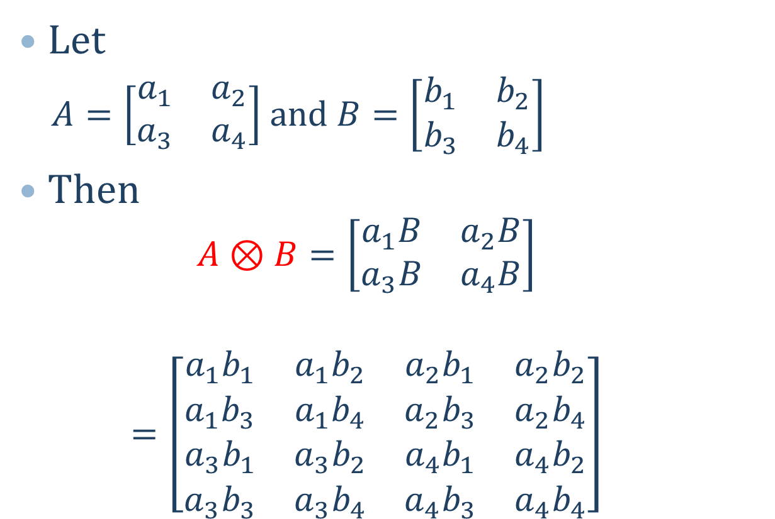
Kronecker (“direct”) products
Let
$A=\left[\begin{matrix}a_{1} & a_{2} \\ a_{3} & a_{4}\end{matrix}\right]$ and $B=\left[\begin{matrix}b_{1} & b_{2} \\ b_{3} & b_{4}\end{matrix}\right]$
Then
$$A⊗B=\left[\begin{matrix}a_{1}B & a_{2}B \\ a_{3}B & a_{4}B\end{matrix}\right]$$
$$=\left[\begin{matrix}{a_{1}b}_{1} & a_{1}b_{2} & {a_{2}b}_{1} & a_{2}b_{2} \\ {a_{1}b}_{3} & a_{1}b_{4} & {a_{2}b}_{3} & a_{2}b_{4} \\ a_{3}b_{1} & a_{3}b_{2} & {a_{4}b}_{1} & {a_{4}b}_{2} \\ a_{3}b_{3} & {a_{3}b}_{4} & a_{4}b_{3} & {a_{4}b}_{4}\end{matrix}\right]$$
Notes:
If you don’t work with Kronecker products a lot, let me remind you of how this operation works.
Each element of the first matrix is used as a scalar to multiply by the second matrix, and they are arranged as a partitioned matrix.

Slide 15
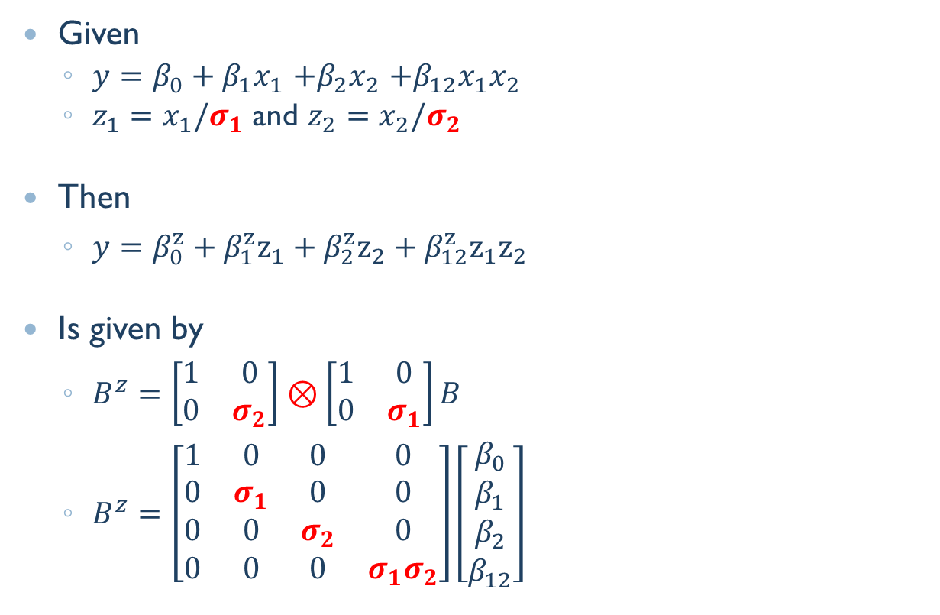
Factorial model rescaling
Given
$y=β_{0}+β_{1}x_{1}$ $+β_{2}x_{2}$ $+β_{12}x_{1}x_{2}$
$z_{1}=x_{1}/σ_{1}$ and $z_{2}=x_{2}/σ_{2}$
Then
$y=β_{0}^{z}+β_{1}^{z}z_{1}+β_{2}^{z}z_{2}+β_{12}^{z}z_{1}z_{2}$
Is given by
$B^{z}=\left[\begin{matrix}1 & 0 \\ 0 & σ_{2}\end{matrix}\right]⊗\left[\begin{matrix}1 & 0 \\ 0 & σ_{1}\end{matrix}\right]B$
$B^{z}=\left[\begin{matrix}1 & 0 & 0 & 0 \\ 0 & σ_{1} & 0 & 0 \\ 0 & 0 & σ_{2} & 0 \\ 0 & 0 & 0 & σ_{1}σ_{2}\end{matrix}\right]\left[\begin{matrix}β_{0} \\ β_{1} \\ β_{2} \\ β_{12}\end{matrix}\right]$
Notes:
Rescaling transformations work the same way as recentering transformations, and we can again use both together to generate standardizing transformations.

Slide 16
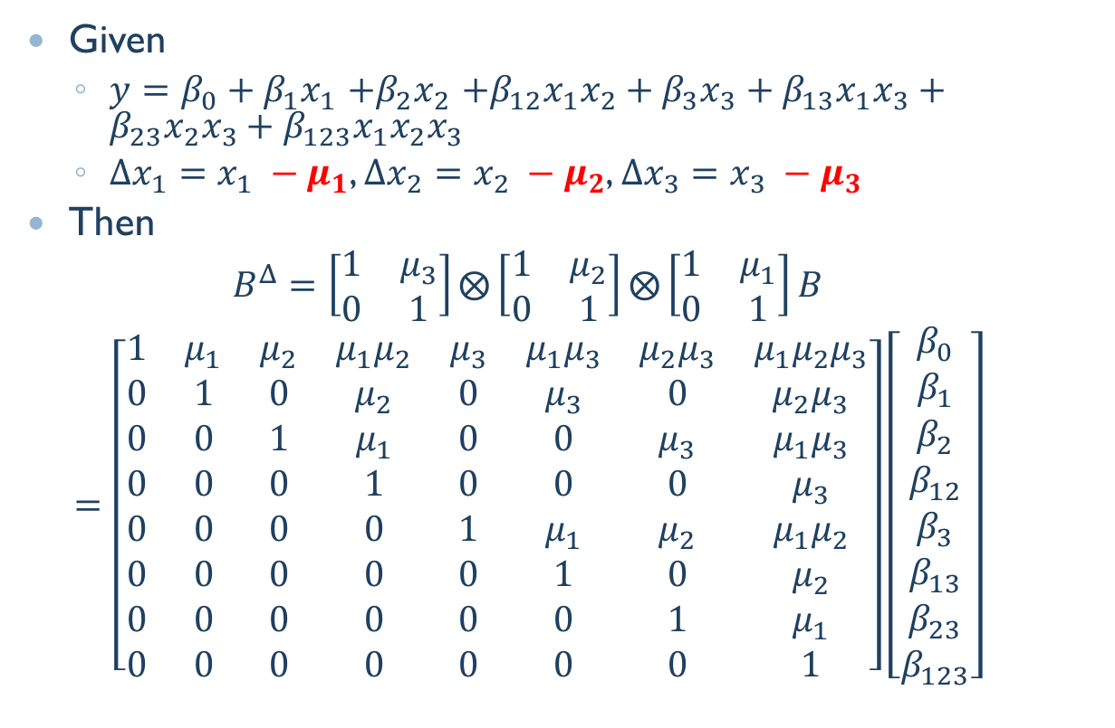
Three-way recentering
Given
$y=β_{0}+β_{1}x_{1}$ $+β_{2}x_{2}$ $+β_{12}x_{1}x_{2}+β_{3}x_{3}+β_{13}x_{1}x_{3}+β_{23}x_{2}x_{3}+β_{123}x_{1}x_{2}x_{3}$
$Δx_{1}=x_{1} −μ_{1}$, $Δx_{2}=x_{2} −μ_{2}$, $Δx_{3}=x_{3} −μ_{3}$
Then
$$B^{Δ}=\left[\begin{matrix}1 & μ_{3} \\ 0 & 1\end{matrix}\right]⨂\left[\begin{matrix}1 & μ_{2} \\ 0 & 1\end{matrix}\right]⨂\left[\begin{matrix}1 & μ_{1} \\ 0 & 1\end{matrix}\right]B$$
$$=\left[\begin{matrix}1 & μ_{1} & μ_{2} & μ_{1}μ_{2} & μ_{3} & μ_{1}μ_{3} & {μ_{2}μ}_{3} & {μ_{1}μ_{2}μ}_{3} \\ 0 & 1 & 0 & μ_{2} & 0 & μ_{3} & 0 & μ_{2}μ_{3} \\ 0 & 0 & 1 & μ_{1} & 0 & 0 & μ_{3} & μ_{1}μ_{3} \\ 0 & 0 & 0 & 1 & 0 & 0 & 0 & μ_{3} \\ 0 & 0 & 0 & 0 & 1 & μ_{1} & μ_{2} & μ_{1}μ_{2} \\ 0 & 0 & 0 & 0 & 0 & 1 & 0 & μ_{2} \\ 0 & 0 & 0 & 0 & 0 & 0 & 1 & μ_{1} \\ 0 & 0 & 0 & 0 & 0 & 0 & 0 & 1\end{matrix}\right]\left[\begin{matrix}β_{0} \\ β_{1} \\ β_{2} \\ β_{12} \\ β_{3} \\ β_{13} \\ β_{23} \\ β_{123}\end{matrix}\right]$$
Notes:
A bigger factorial design just extends the process.
(Point! 1 .. 2 ..3)

Slide 17
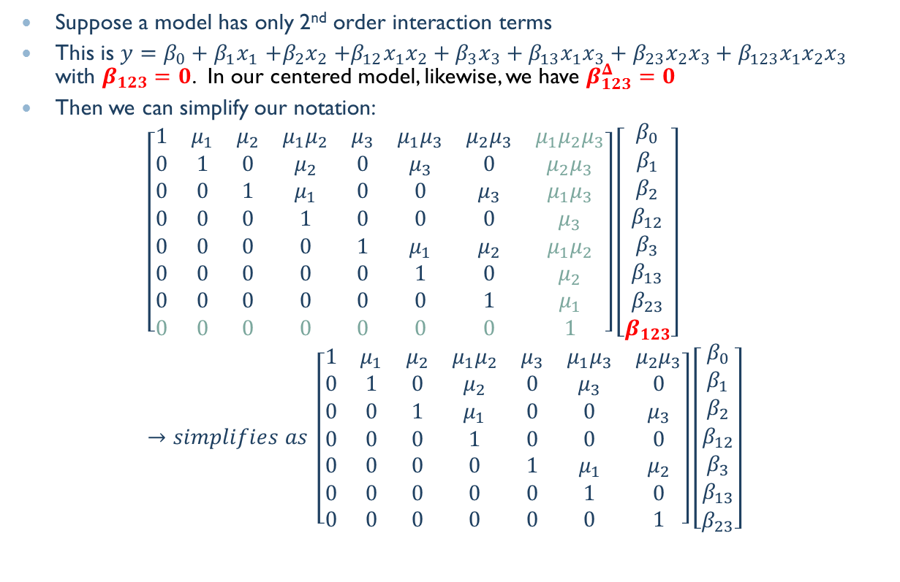
Partial Factorial
Suppose a model has only 2nd order interaction terms
This is $y=β_{0}+β_{1}x_{1}$ $+β_{2}x_{2}$ $+β_{12}x_{1}x_{2}+β_{3}x_{3}+β_{13}x_{1}x_{3}+β_{23}x_{2}x_{3}+β_{123}x_{1}x_{2}x_{3}$ with $β_{123}=0$. In our centered model, likewise, we have $β_{123}^{Δ}=0$
Then we can simplify our notation:
$$\left[\begin{matrix}1 & μ_{1} & μ_{2} & μ_{1}μ_{2} & μ_{3} & μ_{1}μ_{3} & {μ_{2}μ}_{3} & {μ_{1}μ_{2}μ}_{3} \\ 0 & 1 & 0 & μ_{2} & 0 & μ_{3} & 0 & μ_{2}μ_{3} \\ 0 & 0 & 1 & μ_{1} & 0 & 0 & μ_{3} & μ_{1}μ_{3} \\ 0 & 0 & 0 & 1 & 0 & 0 & 0 & μ_{3} \\ 0 & 0 & 0 & 0 & 1 & μ_{1} & μ_{2} & μ_{1}μ_{2} \\ 0 & 0 & 0 & 0 & 0 & 1 & 0 & μ_{2} \\ 0 & 0 & 0 & 0 & 0 & 0 & 1 & μ_{1} \\ 0 & 0 & 0 & 0 & 0 & 0 & 0 & 1\end{matrix}\right]\left[\begin{matrix}β_{0} \\ β_{1} \\ β_{2} \\ β_{12} \\ β_{3} \\ β_{13} \\ β_{23} \\ β_{123}\end{matrix}\right]→simplifies as \left[\begin{matrix}1 & μ_{1} & μ_{2} & μ_{1}μ_{2} & μ_{3} & μ_{1}μ_{3} & {μ_{2}μ}_{3} \\ 0 & 1 & 0 & μ_{2} & 0 & μ_{3} & 0 \\ 0 & 0 & 1 & μ_{1} & 0 & 0 & μ_{3} \\ 0 & 0 & 0 & 1 & 0 & 0 & 0 \\ 0 & 0 & 0 & 0 & 1 & μ_{1} & μ_{2} \\ 0 & 0 & 0 & 0 & 0 & 1 & 0 \\ 0 & 0 & 0 & 0 & 0 & 0 & 1\end{matrix}\right]\left[\begin{matrix}β_{0} \\ β_{1} \\ β_{2} \\ β_{12} \\ β_{3} \\ β_{13} \\ β_{23}\end{matrix}\right]$$
Notes:
Many models are less than full factorial: among other things we want to be able to consider models that are specified with an odd number of terms, and not just even numbers!
We get these transformations by whittling down the full factorial transformation.
Here, if we set the three-way interaction to 0, we essentially zero out a column of our transformation matrix. We can simplify by removing both the column from the matrix and the parameter from the parameter vector.
If we do that, we are left with a row of nothing but zeros. So we can further simplify by dropping that row, and the parameter that is produces.

Slide 18
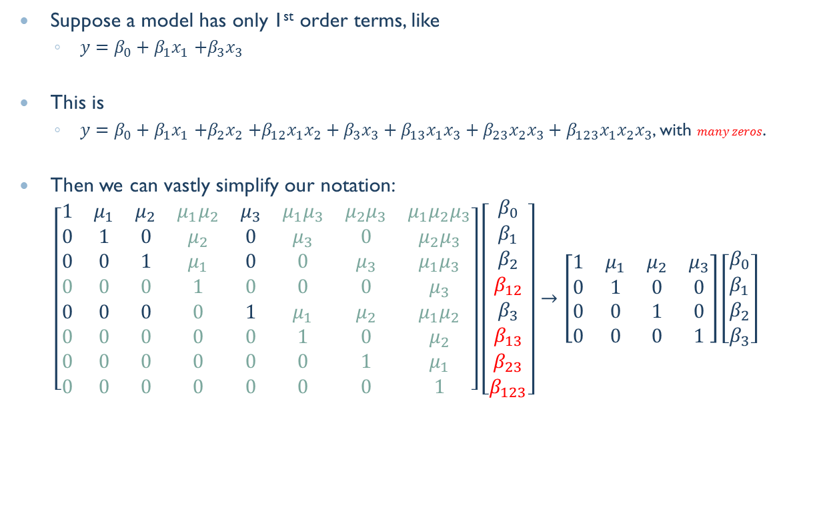
Additive models again
Suppose a model has only 1st order terms, like
$y=β_{0}+β_{1}x_{1}$ $+β_{3}x_{3}$
This is
$y=β_{0}+β_{1}x_{1}$ $+β_{2}x_{2}$ $+β_{12}x_{1}x_{2}+β_{3}x_{3}+β_{13}x_{1}x_{3}+β_{23}x_{2}x_{3}+β_{123}x_{1}x_{2}x_{3}$, with $many zeros$.
Then we can vastly simplify our notation:
$$\left[\begin{matrix}1 & μ_{1} & μ_{2} & μ_{1}μ_{2} & μ_{3} & μ_{1}μ_{3} & {μ_{2}μ}_{3} & {μ_{1}μ_{2}μ}_{3} \\ 0 & 1 & 0 & μ_{2} & 0 & μ_{3} & 0 & μ_{2}μ_{3} \\ 0 & 0 & 1 & μ_{1} & 0 & 0 & μ_{3} & μ_{1}μ_{3} \\ 0 & 0 & 0 & 1 & 0 & 0 & 0 & μ_{3} \\ 0 & 0 & 0 & 0 & 1 & μ_{1} & μ_{2} & μ_{1}μ_{2} \\ 0 & 0 & 0 & 0 & 0 & 1 & 0 & μ_{2} \\ 0 & 0 & 0 & 0 & 0 & 0 & 1 & μ_{1} \\ 0 & 0 & 0 & 0 & 0 & 0 & 0 & 1\end{matrix}\right]\left[\begin{matrix}β_{0} \\ β_{1} \\ β_{2} \\ β_{12} \\ β_{3} \\ β_{13} \\ β_{23} \\ β_{123}\end{matrix}\right]→\left[\begin{matrix}1 & μ_{1} & μ_{2} & μ_{3} \\ 0 & 1 & 0 & 0 \\ 0 & 0 & 1 & 0 \\ 0 & 0 & 0 & 1\end{matrix}\right]\left[\begin{matrix}β_{0} \\ β_{1} \\ β_{2} \\ β_{3}\end{matrix}\right]$$
Notes:
An additive model, then, comes out something like this.
Notice the characteristic pattern: none of the first order terms change, only the intercept, the zero-th order term, is changed.

Slide 19
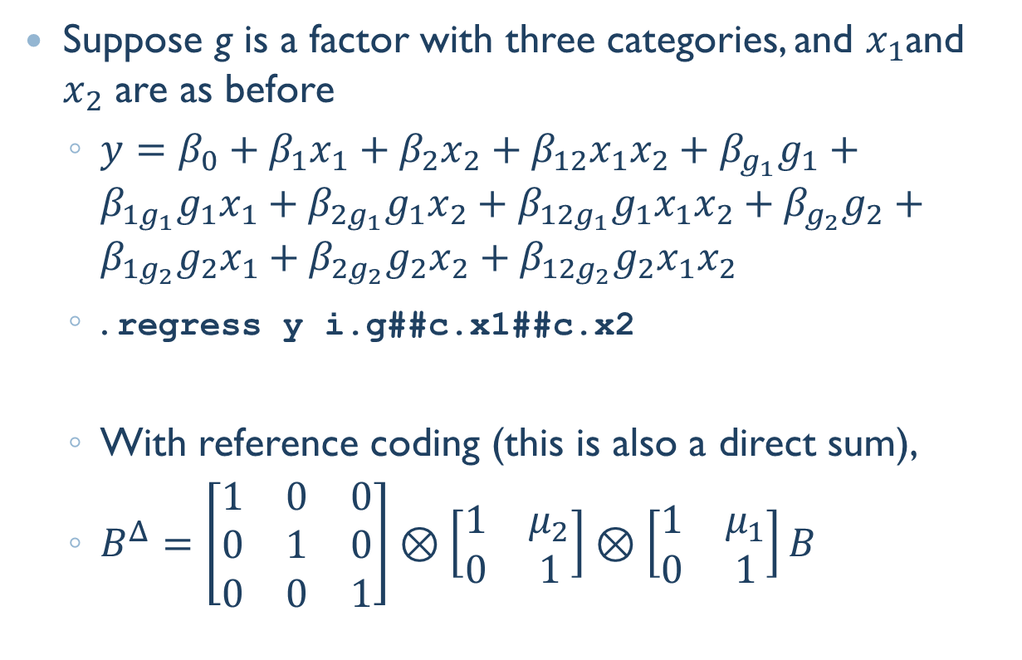
Factor variables
Suppose g is a factor with three categories, and $x_{1}$and $x_{2}$ are as before
$y=β_{0}+β_{1}x_{1}+β_{2}x_{2}+β_{12}x_{1}x_{2}+{β_{g_{1}}g}_{1}+{β_{1g_{1}}g}_{1}x_{1}+β_{2g_{1}}{g_{1}x}_{2}+β_{12g_{1}}{g_{1}x}_{1}x_{2}+{β_{g_{2}}g}_{2}+{β_{1g_{2}}g}_{2}x_{1}+β_{2g_{2}}{g_{2}x}_{2}+β_{12g_{2}}g_{2}x_{1}x_{2}$
. regress y i.g##c.x1##c.x2
With reference coding (this is also a direct sum),
$B^{Δ}=\left[\begin{matrix}1 & 0 & 0 \\ 0 & 1 & 0 \\ 0 & 0 & 1\end{matrix}\right]⊗\left[\begin{matrix}1 & μ_{2} \\ 0 & 1\end{matrix}\right]⊗\left[\begin{matrix}1 & μ_{1} \\ 0 & 1\end{matrix}\right]B$
Notes:
Now let’s think about the intercept, or multiple intercepts.
If we start with reference coding, and use indicators for out categories, we may not want to recenter or rescale.
Then our transformation matrix is just expanded into block diagonal form, and our direct product is equivalent to a direct sum.

Slide 20
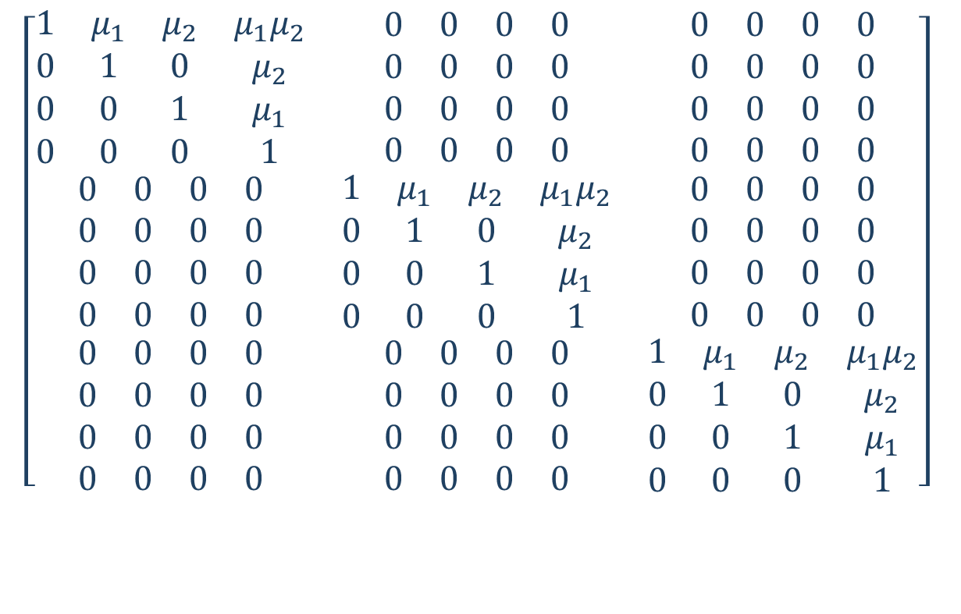
Block diagonal, or direct sum
$$\left[\begin{matrix}\begin{matrix}1 & μ_{1} & μ_{2} & μ_{1}μ_{2} \\ 0 & 1 & 0 & μ_{2} \\ 0 & 0 & 1 & μ_{1} \\ 0 & 0 & 0 & 1\end{matrix} & \begin{matrix}0 & 0 & 0 & 0 \\ 0 & 0 & 0 & 0 \\ 0 & 0 & 0 & 0 \\ 0 & 0 & 0 & 0\end{matrix} & \begin{matrix}0 & 0 & 0 & 0 \\ 0 & 0 & 0 & 0 \\ 0 & 0 & 0 & 0 \\ 0 & 0 & 0 & 0\end{matrix} \\ \begin{matrix}0 & 0 & 0 & 0 \\ 0 & 0 & 0 & 0 \\ 0 & 0 & 0 & 0 \\ 0 & 0 & 0 & 0\end{matrix} & \begin{matrix}1 & μ_{1} & μ_{2} & μ_{1}μ_{2} \\ 0 & 1 & 0 & μ_{2} \\ 0 & 0 & 1 & μ_{1} \\ 0 & 0 & 0 & 1\end{matrix} & \begin{matrix}0 & 0 & 0 & 0 \\ 0 & 0 & 0 & 0 \\ 0 & 0 & 0 & 0 \\ 0 & 0 & 0 & 0\end{matrix} \\ \begin{matrix}0 & 0 & 0 & 0 \\ 0 & 0 & 0 & 0 \\ 0 & 0 & 0 & 0 \\ 0 & 0 & 0 & 0\end{matrix} & \begin{matrix}0 & 0 & 0 & 0 \\ 0 & 0 & 0 & 0 \\ 0 & 0 & 0 & 0 \\ 0 & 0 & 0 & 0\end{matrix} & \begin{matrix}1 & μ_{1} & μ_{2} & μ_{1}μ_{2} \\ 0 & 1 & 0 & μ_{2} \\ 0 & 0 & 1 & μ_{1} \\ 0 & 0 & 0 & 1\end{matrix}\end{matrix}\right]$$
Notes:
So with three categories and two continuous variables, if I want to leave the model reference coded my transformation matrix looks like this.
One way to think of this is that I can create the transformation matrix for my covariates, and reuse it.

Slide 21
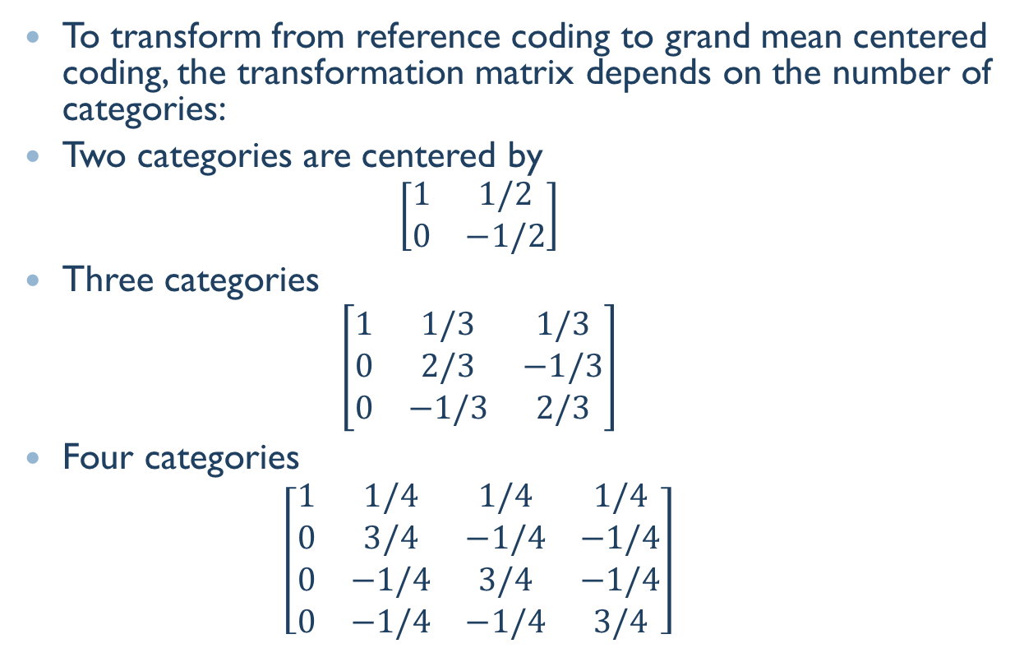
Factor Grand Mean Centering
To transform from reference coding to grand mean centered coding, the transformation matrix depends on the number of categories:
Two categories are centered by
$$\left[\begin{matrix}1 & 1/2 \\ 0 & −1/2\end{matrix}\right]$$
Three categories
$$\left[\begin{matrix}1 & 1/3 & 1/3 \\ 0 & 2/3 & −1/3 \\ 0 & −1/3 & 2/3\end{matrix}\right]$$
Four categories
$$\left[\begin{matrix}1 & 1/4 & 1/4 & 1/4 \\ 0 & 3/4 & −1/4 & −1/4 \\ 0 & −1/4 & 3/4 & −1/4 \\ 0 & −1/4 & −1/4 & 3/4\end{matrix}\right]$$
Notes:
We could also consider other approaches to coding categorical variables.
I haven’t built this into my little package, so I’m just mentioning that there is nothing that requires us to stick with reference coding.

Slide 22

Grand Mean transformation
For $n$ categories:
$$\left[\begin{matrix}1 & 1/n & ⋯ & 1/n \\ 0 & \frac{n−1}{n} & −1/n & −1/n \\ ⋮ & −1/n & ⋱ & ⋮ \\ 0 & −1/n & ⋯ & \frac{n−1}{n}\end{matrix}\right]$$
Notes:
I think it is useful to think about how this matrix relates to the “data centering” matrix you find in textbooks.

Slide 23
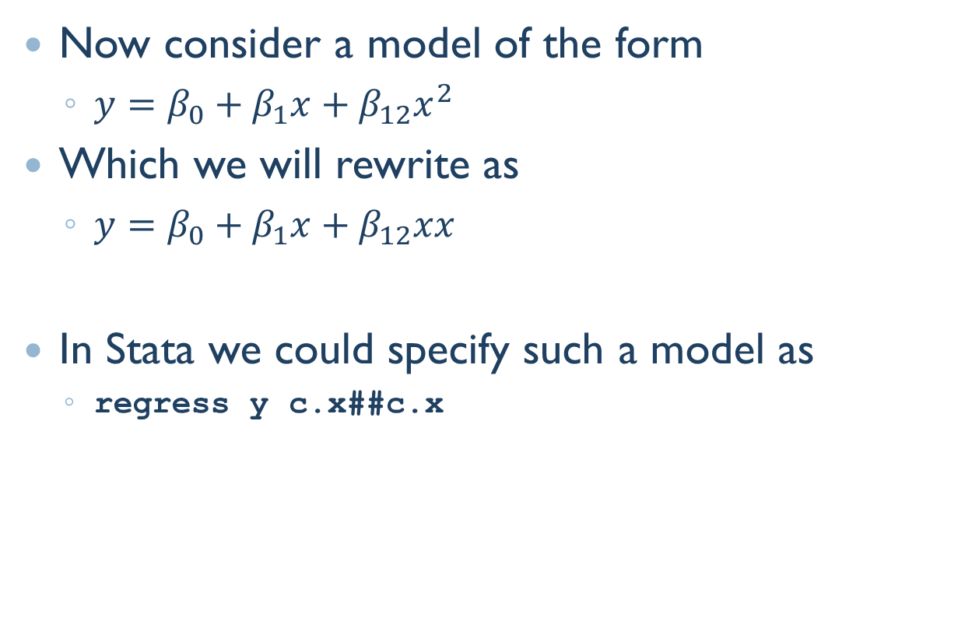
Polynomial terms
Now consider a model of the form
$y=β_{0}+β_{1}x+β_{12}x^{2}$
Which we will rewrite as
$y=β_{0}+β_{1}x+β_{12}xx$
In Stata we could specify such a model as
regress y c.x##c.x
Notes:
Finally we turn to polynomial models.
We can recast the polynomial terms as interactions.
(This is something you cannot do in R, by the way.)
Notice that we have only 1 first order term instead of the usual 2 terms that we see in other factorial models.
What we have done is collected our “x” terms.

Slide 24
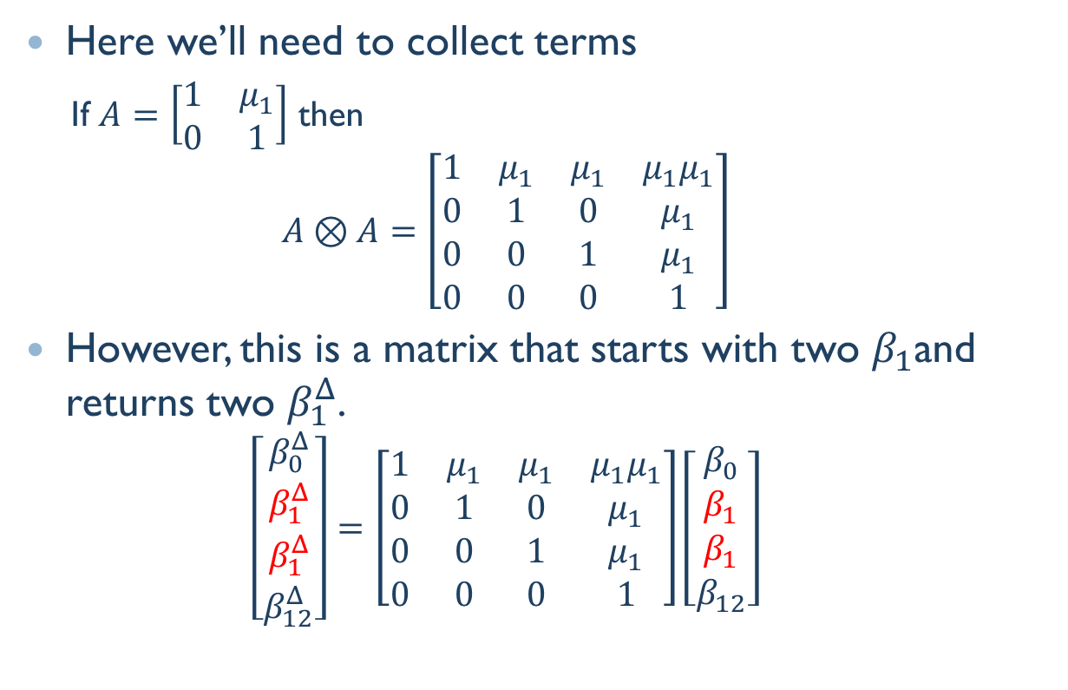
Polynomial Terms
Here we’ll need to collect terms
If $A=\left[\begin{matrix}1 & μ_{1} \\ 0 & 1\end{matrix}\right]$ then
$$A⊗A=\left[\begin{matrix}1 & μ_{1} & μ_{1} & μ_{1}μ_{1} \\ 0 & 1 & 0 & μ_{1} \\ 0 & 0 & 1 & μ_{1} \\ 0 & 0 & 0 & 1\end{matrix}\right]$$
However, this is a matrix that starts with two $β_{1}$and returns two $β_{1}^{Δ}$.
$$\left[\begin{matrix}\begin{aligned}β_{0}^{Δ} \\ β_{1}^{Δ}\end{aligned} \\ β_{1}^{Δ} \\ β_{12}^{Δ}\end{matrix}\right]=\left[\begin{matrix}1 & μ_{1} & μ_{1} & μ_{1}μ_{1} \\ 0 & 1 & 0 & μ_{1} \\ 0 & 0 & 1 & μ_{1} \\ 0 & 0 & 0 & 1\end{matrix}\right]\left[\begin{matrix}\begin{aligned}β_{0} \\ β_{1}\end{aligned} \\ β_{1} \\ β_{12}\end{matrix}\right]$$
Notes:
So we will need to collect terms in our transformation matrix.
Begin with the usual Kronecker operation for a factorial model.

Slide 25
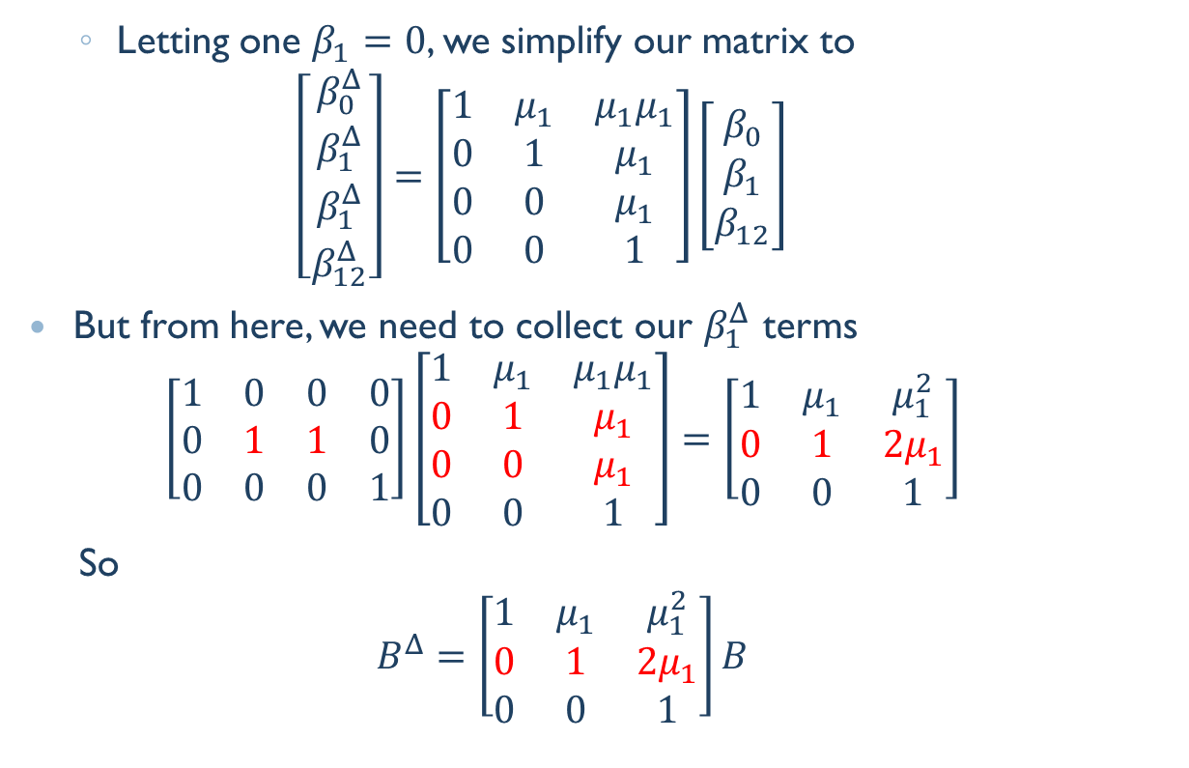
Polynomial Terms
Letting one $β_{1}=0$, we simplify our matrix to
$$\left[\begin{matrix}\begin{aligned}β_{0}^{Δ} \\ β_{1}^{Δ}\end{aligned} \\ β_{1}^{Δ} \\ β_{12}^{Δ}\end{matrix}\right]=\left[\begin{matrix}1 & μ_{1} & μ_{1}μ_{1} \\ 0 & 1 & μ_{1} \\ 0 & 0 & μ_{1} \\ 0 & 0 & 1\end{matrix}\right]\left[\begin{matrix}β_{0} \\ β_{1} \\ β_{12}\end{matrix}\right]$$
But from here, we need to collect our $β_{1}^{Δ}$ terms
$$\left[\begin{matrix}1 & 0 & 0 & 0 \\ 0 & 1 & 1 & 0 \\ 0 & 0 & 0 & 1\end{matrix}\right]\left[\begin{matrix}1 & μ_{1} & μ_{1}μ_{1} \\ 0 & 1 & μ_{1} \\ 0 & 0 & μ_{1} \\ 0 & 0 & 1\end{matrix}\right]=\left[\begin{matrix}1 & μ_{1} & μ_{1}^{2} \\ 0 & 1 & {2μ}_{1} \\ 0 & 0 & 1\end{matrix}\right]$$
So
$$B^{Δ}=\left[\begin{matrix}1 & μ_{1} & μ_{1}^{2} \\ 0 & 1 & {2μ}_{1} \\ 0 & 0 & 1\end{matrix}\right]B$$
Notes:
We start to simplify like we did with the partial factorial models.
However, now zeroing out a column no longer leaves us with any rows of zeros.
This transformation still produces two $β_{1}^{Δ}$ terms.
So we collect those terms: we add them together.
This is the result.
There are more terms to collect in higher order models, but this is the basic idea.

Slide 26
Math Summary
We have building blocks for:
Continuous variables
Categorical variables
Polynomial terms
We can combine them as:
Factorial models
Subsets of terms from factorial models
(As long as no higher-order terms appear without their related lower-order terms)

Slide 27
Programming – Stata
Given a model in Stata, we want to
Identify variables, variable types, variables’ polynomial degree (macro list functions and _ms_parse_parts)
Collect recentering and rescaling constants (tabstat)
Form factorial transformation matrices for continuous/polynomial terms (Kronecker matrix operator, #)
Build complete model transformation matrices by filling constants into the appropriate slots (matrix extraction and substitution)
Use the results (estimates store and estimates table)
Notes:
(I’m not going to go through these in order, but just highlight those parts I thought were obscure yet critically useful.)

Slide 28
Kronecker product terms
In the matrix language, Kronecker products make it easy to track terms
. matrix list A
A[2,2]
_ weight
r1 1 3019.4595
r2 0 1
. matrix list B
B[2,2]
_ displacement
r1 1 197.2973
r2 0 1
. matrix C = B#A
Notes:
One issue with these transformation matrices is keeping track of which rows and which columns relate to which parameters.
In the matrix language, Stata’s Kronecker operator makes it easy to keep track of your terms.

Slide 29
Kronecker product terms
Column/row names are returned with the form
equation(B):name(A)
. matrix list C
C[4,4]
displacem~t: displacem~t:
_ weight _ weight
r1:r1 1 3019.4595 197.2973 595731.19
r1:r2 0 1 0 197.2973
r2:r1 0 0 1 3019.4595
r2:r2 0 0 0 1
Note the name stripe is used, but the equation stripe is lost.
Notes:
It returns two-part names, with the equation part from the first matrix, and the name part from the second matrix. The parts are separated by a colon.

Slide 30
Combine term parts
To use this further, we move all the variable names into the name stripe
. local cn : colfullnames C
. local cn :subinstr local cn ":" "#", all
. local cn :subinstr local cn "#_" "", all
. matrix coleq C = ""
. matrix colnames C =`cn'
. matrix list C
C[4,4]
c.displace~t#
_ weight displacement c.weight
r1:r1 1 3019.4595 197.2973 595731.19
r1:r2 0 1 0 197.2973
r2:r1 0 0 1 3019.4595
r2:r2 0 0 0 1
Note matrix understands these are interaction terms!
Notes:
In subsequent operations, the equation part is lost, so we need to move term names around if we want to keep them.

Slide 31
Kronecker product terms
And we can keep building …
. matrix C = D#C
. matrix list C
C[8,8]
c.mpg#
c.displace~t# c.mpg# c.mpg# c.displace~t#
_ weight displacement c.weight mpg c.weight c.displace~t c.weight
r1:r1 1 3019.4595 197.2973 595731.19 21.297297 64306.326 4201.8992 12687464
r1:r2 0 1 0 197.2973 0 21.297297 0 4201.8992
r1:r1 0 0 1 3019.4595 0 0 21.297297 64306.326
r1:r2 0 0 0 1 0 0 0 21.297297
r2:r1 0 0 0 0 1 3019.4595 197.2973 595731.19
r2:r2 0 0 0 0 0 1 0 197.2973
r2:r1 0 0 0 0 0 0 1 3019.4595
r2:r2 0 0 0 0 0 0 0 1

Slide 32
Parse covariates from factors
Use _ms_parse_parts with terms from e(b)
. quietly regress price foreign##c.weight
. matrix list e(b)
e(b)[1,6]
0b. 1. 0b.foreign# 1.foreign#
foreign foreign weight co.weight c.weight _cons
y1 0 -2171.5968 2.9948135 0 2.3672266 -3861.719
. _ms_parse_parts weight
. return list // "variable"
scalars:
r(omit) = 0
macros:
r(name) : "weight"
r(type) : "variable"
Notes:
Another thing I want to do is separate out intercept terms from all the higher order terms.
The Stata command _ms_pars_parts is an amazingly useful tool!
You give it the name of a term, and it parses it into parts.

Slide 33
Parse factors from covariates
Factors
. _ms_parse_parts 1.foreign
. return list // "factor"
scalars:
r(base) = 0
r(level) = 1
r(omit) = 0
macros:
r(name) : "foreign"
r(op) : "1"
r(type) : "factor"

Slide 34
Parse interactions
Interactions
. _ms_parse_parts 1.foreign#c.weight
. return list // "interaction"
scalars:
r(base1) = 0
r(level1) = 1
r(k_names) = 2
r(omit) = 0
macros:
r(name2) : "weight"
r(op2) : "c"
r(name1) : "foreign"
r(op1) : "1"
r(type) : "interaction"

Slide 35
Parse polynomials
Polynomial terms require some extra parsing
. _ms_parse_parts whatever#c.whatever
. return list // polynomial as interaction
scalars:
r(k_names) = 2
r(omit) = 0
macros:
r(name2) : "whatever"
r(op2) : "c"
r(name1) : "whatever"
r(op1) : "c"
r(type) : "interaction"

Slide 36
Matrix extraction/substitution
Recognizes factor notation equivalences!
. quietly regress price c.weight##c.disp
. matrix A = e(b)
. matrix B= A[1,1..2] // by numerical index
. matrix B= A[1,"weight"] // by column/row names
. matrix B= A[1,"c.weight#c.displacement"]
. matrix list B
c.weight#
c.displace~t
y1 .0143162
. matrix B= A[1,"c.displacement#c.weight"]
. matrix list B
c.weight#
c.displace~t
y1 .0143162
Notes:
Once we have sorted the covariates from the categorical variables, and formed our transformation matrix for the covariates, we can use matrix extraction and substitution to plug the components into a larger parameter transformation matrix that accommodates the categorical terms.
Here, it is useful to realize that factor variable notation is built into matrix extraction and substitution.

Slide 37
stdParm syntax
stdParm [ , nodepvar store replace estimates_table_options]
Produces centered and standardized parameters
Optionally exclude the response variable
Results can be stored
Results can be reported with any estimates table options
Notes:
So I’ve put these pieces together into a little software routine, that works after regress and glm.

Slide 38
stdParm use
. quietly regress price c.weight##c.mpg
. stdParm
-----------------------------------------------------------
Variable | Original Centered Standardized
-------------+---------------------------------------------
weight | 5.0670077 .98475137 .25948245
mpg | 396.78438 -181.98425 -.35696623
|
c.weight#|
c.mpg | -.19167955 -.19167955 -.29221218
|
_cons | -5944.8806 -686.28559 -.23267895
-----------------------------------------------------------

Slide 39
stdParm additional statistics
. stdParm, stats(N r2) star
--------------------------------------------------------------------
Variable | Original Centered Standardized
-------------+------------------------------------------------------
weight | 5.0670077*** .98475137 .25948245
mpg | 396.78438* -181.98425 -.35696623
|
c.weight#|
c.mpg | -.19167955** -.19167955** -.29221218**
|
_cons | -5944.8806 -686.28559 -.23267895
-------------+------------------------------------------------------
N | 74 74 74
r2 | .35969597 .35969597 .35969597
--------------------------------------------------------------------
legend: * p<0.05; ** p<0.01; *** p<0.001

Slide 40
stdParm after logit
. quietly logit foreign c.price##c.weight
. stdParm
-----------------------------------------------------------
Variable | Original Centered Standardized
-------------+---------------------------------------------
price | .00331766 .00113549 3.3491337
weight | -.00141654 -.00587217 -4.5638148
|
c.price#|
c.weight | -7.227e-07 -7.227e-07 -1.6566669
|
_cons | -4.5154515 -1.7920268 -1.7920268
-----------------------------------------------------------

Slide 41
stdParm, eform
. quietly logit foreign c.price##c.weight
. stdParm, eform
-----------------------------------------------------------
Variable | Original Centered Standardized
-------------+---------------------------------------------
price | 1.0033232 1.0011361 28.478052
weight | .99858446 .99414503 .01042222
|
c.price#|
c.weight | .99999928 .99999928 .19077378
|
_cons | .01093867 .16662211 .16662211
-----------------------------------------------------------

Slide 42
Download/ install
net from www.ssc.wisc.edu/~hemken/Stataworkshops
Tinker with the source code, suggest improvements:
https://github.com/Hemken/stdParm

